Slide 1
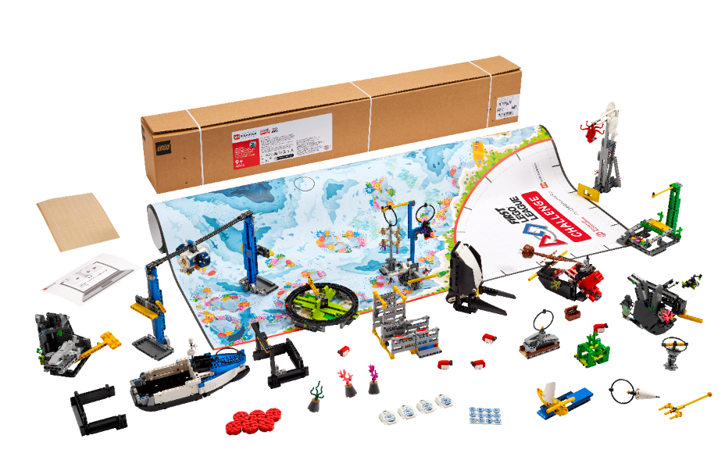


Session 6
Identify Solutions
Notes:
Facilitator Tips - Provide extra paper or a shared online file for the team to capture the process used to create their robot and innovation project solutions. The team will be judged on their final robot and project solutions as well as the process they used.
Session 6 Tips =
Building the experts in Bag 13 is a great time for the team to review what they learned about the Project Sparks.
Provide sticky notes and planning cards for the team to place on the mat to map out their mission strategy.
Encourage the team to find the missions where points can be scored most easily and do them first.
The Pseudocode page can be photocopied. It can be used for each mission the team attempts.

Slide 2
Session Overview
Outcomes
The team will create a mission strategy plan and write pseudocode for a mission.
The team will conduct research on their identified problem and start the Innovation Project Planning page.
Notes:
Session Outcomes
Create a mission strategy plan and write pseudocode for a mission.
Conduct research on their identified problem and start the Innovation Project Planning page.
Facilitator Tips - Provide extra paper or a shared online file for the team to capture the process used to create their robot and innovation project solutions. The team will be judged on their final robot and project solutions as well as the process they used.
Session 6 Tips =
The team should pause to reflect on the last few sessions. What does the team feel proud of? What are they excited about?
Provide sticky notes and planning cards for the team to place on the mat to map out their mission strategy.
Encourage the team to find the missions where points can be scored most easily and do them first.
The Pseudocode page can be photocopied. It can be used for each mission the team attempts.
Be sure the team collects their sources in a shared location, either online or on paper.
Take some extra time with the team if needed to explore all the solution ideas and narrow it down to one.
The Innovation Project Planning page can be completed over multiple sessions and helps the team document their process.
The team will begin to develop their innovation project solution in the next session.

Slide 3
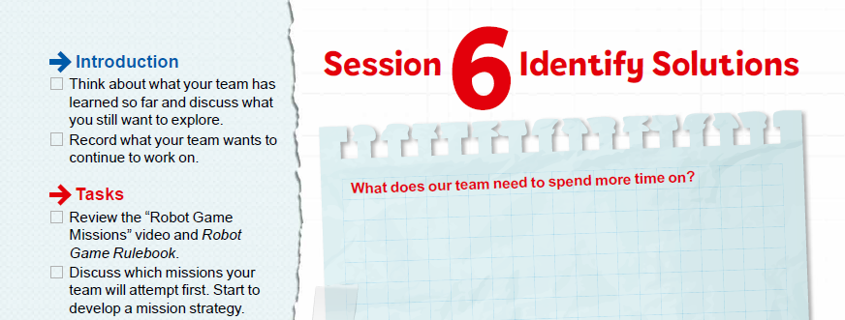
Introduction
Think about what your team has learned so far and discuss what you still want to explore.
Record what your team wants to continue to work on.
Notes:
Introduction (10-15 minutes)
Session Outcomes
Create a mission strategy plan and write pseudocode for a mission.
Conduct research on their identified problem and start the Innovation Project Planning page.
Facilitator Tips - Provide extra paper or a shared online file for the team to capture the process used to create their robot and innovation project solutions. The team will be judged on their final robot and project solutions as well as the process they used.
Session 6 Tips =
The team should pause to reflect on the last few sessions. What does the team feel proud of? What are they excited about?
Provide sticky notes and planning cards for the team to place on the mat to map out their mission strategy.
Encourage the team to find the missions where points can be scored most easily and do them first.
The Pseudocode page can be photocopied. It can be used for each mission the team attempts.
Be sure the team collects their sources in a shared location, either online or on paper.
Take some extra time with the team if needed to explore all the solution ideas and narrow it down to one.
The Innovation Project Planning page can be completed over multiple sessions and helps the team document their process.
The team will begin to develop their innovation project solution in the next session.

Slide 4


Pseudocode & Mission Strategy
Watch the “Robot Game Missions” video.
Visit the
FIRST® LEGO® League
YouTube Channel
to watch the SUBMERGEDSM
“Robot Game Missions” video
Notes:
Mission videos can be found in the Robot Game Rulebook too!
Missions are tasks that can be completed for points. The missions are explained in this section, which should be read by the team as they stand next to the field.
Introduction (10-15 minutes)
Session Outcomes
Create a mission strategy plan and write pseudocode for a mission.
Conduct research on their identified problem and start the Innovation Project Planning page.
Facilitator Tips - Provide extra paper or a shared online file for the team to capture the process used to create their robot and innovation project solutions. The team will be judged on their final robot and project solutions as well as the process they used.
Session 6 Tips =
The team should pause to reflect on the last few sessions. What does the team feel proud of? What are they excited about?
Provide sticky notes and planning cards for the team to place on the mat to map out their mission strategy.
Encourage the team to find the missions where points can be scored most easily and do them first.
The Pseudocode page can be photocopied. It can be used for each mission the team attempts.
Be sure the team collects their sources in a shared location, either online or on paper.
Take some extra time with the team if needed to explore all the solution ideas and narrow it down to one.
The Innovation Project Planning page can be completed over multiple sessions and helps the team document their process.
The team will begin to develop their innovation project solution in the next session.

Slide 5
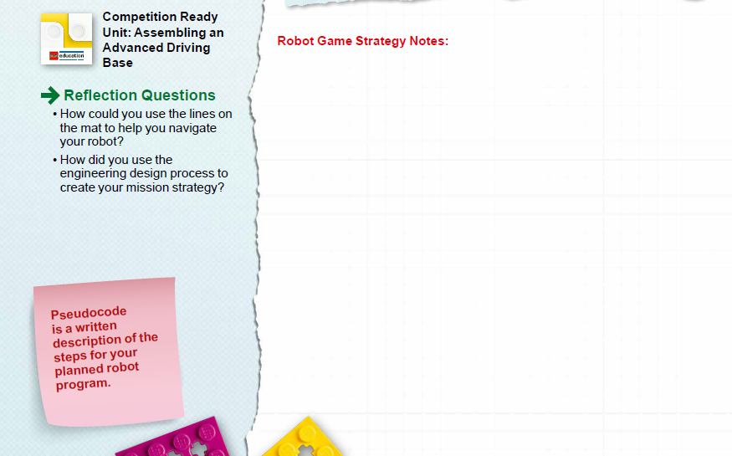

Pseudocode & Mission Strategy
Discuss which missions your team will attempt first. Start to develop a mission strategy.
Come up with a plan to effectively test and improve your robot.
Notes:
Team Tasks (100-120 minutes)
Introduction (10-15 minutes)
Session Outcomes
Create a mission strategy plan and write pseudocode for a mission.
Conduct research on their identified problem and start the Innovation Project Planning page.
Facilitator Tips - Provide extra paper or a shared online file for the team to capture the process used to create their robot and innovation project solutions. The team will be judged on their final robot and project solutions as well as the process they used.
Session 6 Tips =
The team should pause to reflect on the last few sessions. What does the team feel proud of? What are they excited about?
Provide sticky notes and planning cards for the team to place on the mat to map out their mission strategy.
Encourage the team to find the missions where points can be scored most easily and do them first.
The Pseudocode page can be photocopied. It can be used for each mission the team attempts.
Be sure the team collects their sources in a shared location, either online or on paper.
Take some extra time with the team if needed to explore all the solution ideas and narrow it down to one.
The Innovation Project Planning page can be completed over multiple sessions and helps the team document their process.
The team will begin to develop their innovation project solution in the next session.

Slide 6
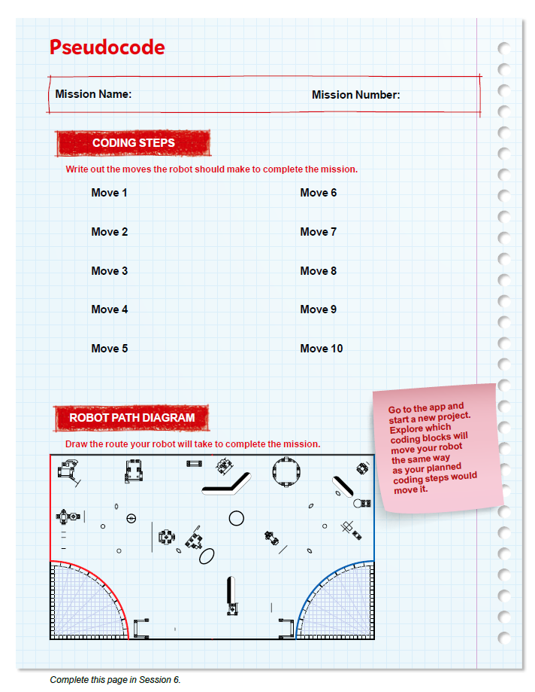

Pseudocode & Mission Strategy
Complete Pseudocode page 22.
Notes:
Team Tasks (100-120 minutes)
Introduction (10-15 minutes)
Session Outcomes
Create a mission strategy plan and write pseudocode for a mission.
Conduct research on their identified problem and start the Innovation Project Planning page.
Facilitator Tips - Provide extra paper or a shared online file for the team to capture the process used to create their robot and innovation project solutions. The team will be judged on their final robot and project solutions as well as the process they used.
Session 6 Tips =
The team should pause to reflect on the last few sessions. What does the team feel proud of? What are they excited about?
Provide sticky notes and planning cards for the team to place on the mat to map out their mission strategy.
Encourage the team to find the missions where points can be scored most easily and do them first.
The Pseudocode page can be photocopied. It can be used for each mission the team attempts.
Be sure the team collects their sources in a shared location, either online or on paper.
Take some extra time with the team if needed to explore all the solution ideas and narrow it down to one.
The Innovation Project Planning page can be completed over multiple sessions and helps the team document their process.
The team will begin to develop their innovation project solution in the next session.

Slide 7

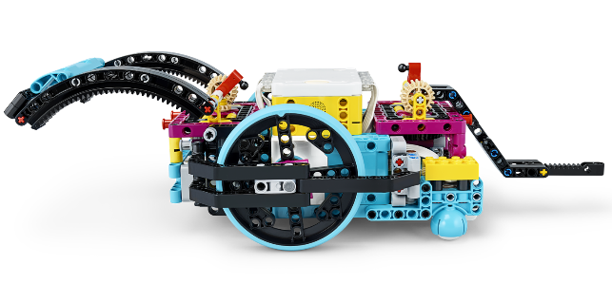
Pseudocode & Mission Strategy
Think about how the program will make your robot act.
Revisit the earlier lessons or do the optional lesson listed here.
Notes:
Team Tasks (100-120 minutes) Assembling an Advanced Driving Base – https://education.lego.com/en-us/lessons/prime-competition-ready/assembling-an-advanced-driving-base#lesson-plan
URL for SPIKE on-line: https://spike.legoeducation.com (remember to use a Chrome browser)
Introduction (10-15 minutes)
Session Outcomes
Create a mission strategy plan and write pseudocode for a mission.
Conduct research on their identified problem and start the Innovation Project Planning page.
Facilitator Tips - Provide extra paper or a shared online file for the team to capture the process used to create their robot and innovation project solutions. The team will be judged on their final robot and project solutions as well as the process they used.
Session 6 Tips =
The team should pause to reflect on the last few sessions. What does the team feel proud of? What are they excited about?
Provide sticky notes and planning cards for the team to place on the mat to map out their mission strategy.
Encourage the team to find the missions where points can be scored most easily and do them first.
The Pseudocode page can be photocopied. It can be used for each mission the team attempts.
Be sure the team collects their sources in a shared location, either online or on paper.
Take some extra time with the team if needed to explore all the solution ideas and narrow it down to one.
The Innovation Project Planning page can be completed over multiple sessions and helps the team document their process.
The team will begin to develop their innovation project solution in the next session.

Slide 8
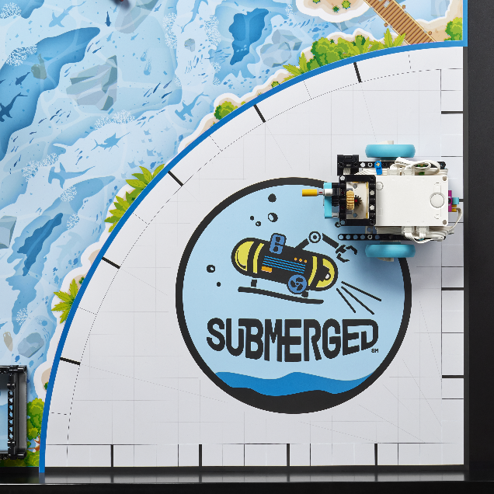
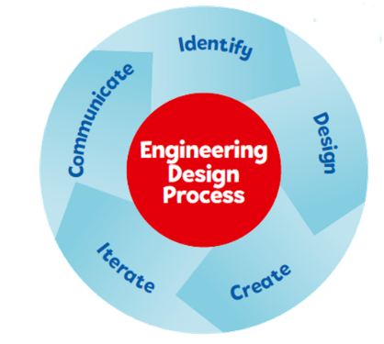
Reflection Questions
How could you use the lines on the mat to help you navigate your robot?
How did you use the engineering design process to create your mission strategy?
Notes:
Team Tasks (100-120 minutes)
Session Outcomes
Create a mission strategy plan and write pseudocode for a mission.
Conduct research on their identified problem and start the Innovation Project Planning page.
Facilitator Tips - Provide extra paper or a shared online file for the team to capture the process used to create their robot and innovation project solutions. The team will be judged on their final robot and project solutions as well as the process they used.
Session 6 Tips =
The team should pause to reflect on the last few sessions. What does the team feel proud of? What are they excited about?
Provide sticky notes and planning cards for the team to place on the mat to map out their mission strategy.
Encourage the team to find the missions where points can be scored most easily and do them first.
The Pseudocode page can be photocopied. It can be used for each mission the team attempts.
Be sure the team collects their sources in a shared location, either online or on paper.
Take some extra time with the team if needed to explore all the solution ideas and narrow it down to one.
The Innovation Project Planning page can be completed over multiple sessions and helps the team document their process.
The team will begin to develop their innovation project solution in the next session.

Slide 9
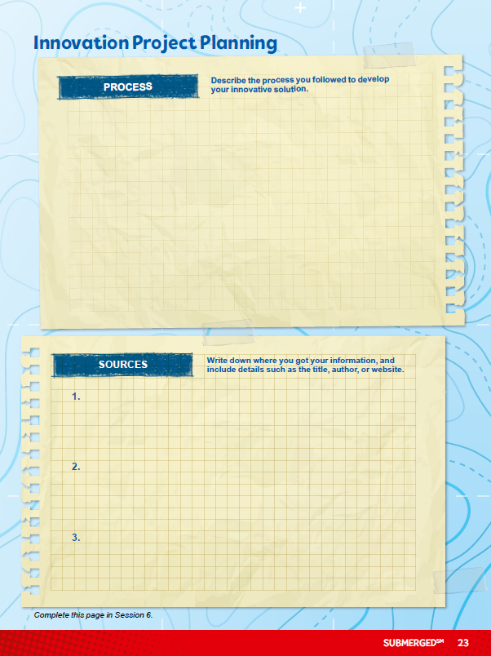
Identify Solutions
Continue to research the problem you chose and any existing solutions.
Make a plan for how you will develop your solution. Use page 23, Innovation Project Planning, as a tool.
Notes:
Team Tasks (100-120 minutes)
Session Outcomes
Create a mission strategy plan and write pseudocode for a mission.
Conduct research on their identified problem and start the Innovation Project Planning page.
Facilitator Tips - Provide extra paper or a shared online file for the team to capture the process used to create their robot and innovation project solutions. The team will be judged on their final robot and project solutions as well as the process they used.
Session 6 Tips =
The team should pause to reflect on the last few sessions. What does the team feel proud of? What are they excited about?
Provide sticky notes and planning cards for the team to place on the mat to map out their mission strategy.
Encourage the team to find the missions where points can be scored most easily and do them first.
The Pseudocode page can be photocopied. It can be used for each mission the team attempts.
Be sure the team collects their sources in a shared location, either online or on paper.
Take some extra time with the team if needed to explore all the solution ideas and narrow it down to one.
The Innovation Project Planning page can be completed over multiple sessions and helps the team document their process.
The team will begin to develop their innovation project solution in the next session.

Slide 10
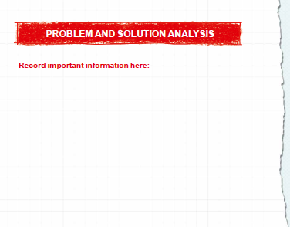
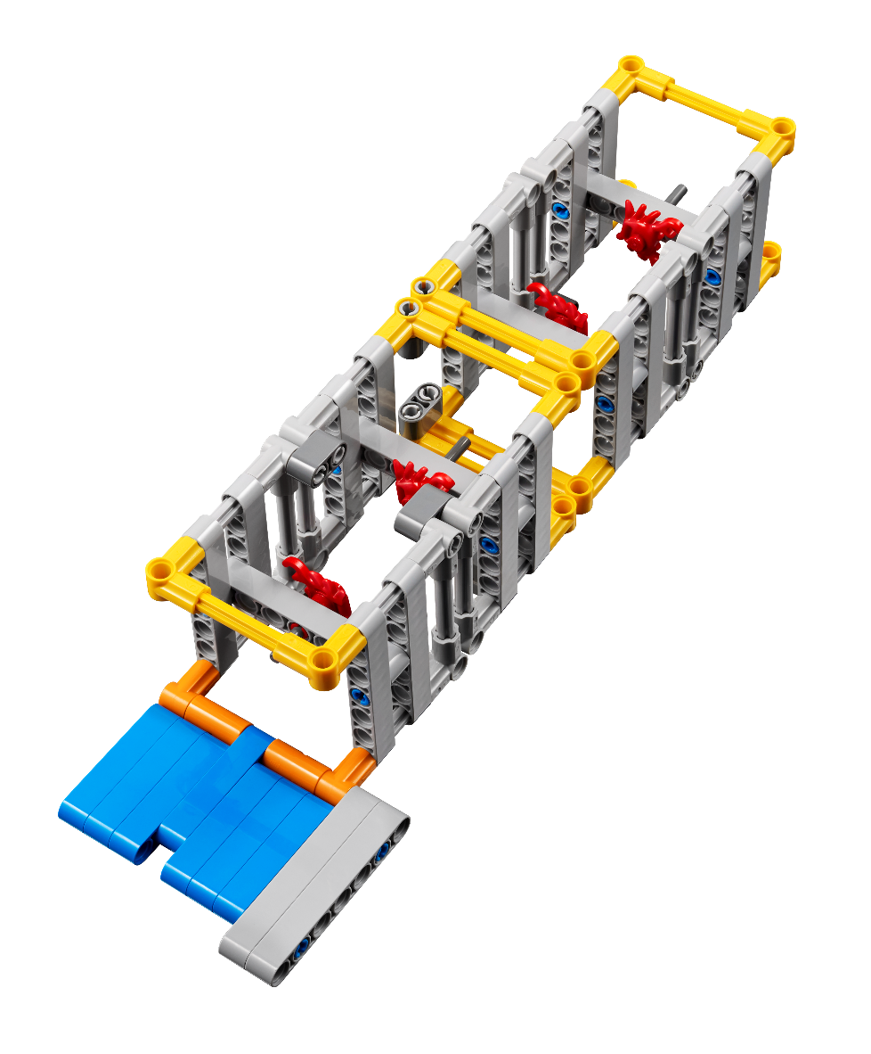
Plan Innovation Project Solutions
Use a variety of sources and keep track of them on the Innovation Project Planning page.
Select your project’s final solution as a team.
Notes:
Team Tasks (100-120 minutes)
Session Outcomes
Create a mission strategy plan and write pseudocode for a mission.
Conduct research on their identified problem and start the Innovation Project Planning page.
Facilitator Tips - Provide extra paper or a shared online file for the team to capture the process used to create their robot and innovation project solutions. The team will be judged on their final robot and project solutions as well as the process they used.
Session 6 Tips =
The team should pause to reflect on the last few sessions. What does the team feel proud of? What are they excited about?
Provide sticky notes and planning cards for the team to place on the mat to map out their mission strategy.
Encourage the team to find the missions where points can be scored most easily and do them first.
The Pseudocode page can be photocopied. It can be used for each mission the team attempts.
Be sure the team collects their sources in a shared location, either online or on paper.
Take some extra time with the team if needed to explore all the solution ideas and narrow it down to one.
The Innovation Project Planning page can be completed over multiple sessions and helps the team document their process.
The team will begin to develop their innovation project solution in the next session.

Slide 11
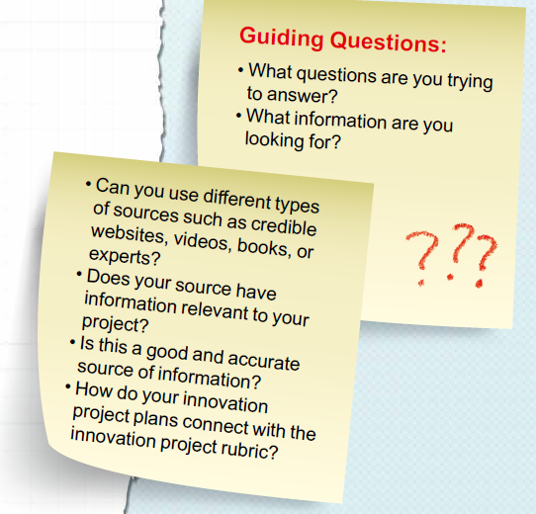

Plan Innovation Project Solutions
Notes:
Team Tasks (100-120 minutes)
Session Outcomes
Create a mission strategy plan and write pseudocode for a mission.
Conduct research on their identified problem and start the Innovation Project Planning page.
Facilitator Tips - Provide extra paper or a shared online file for the team to capture the process used to create their robot and innovation project solutions. The team will be judged on their final robot and project solutions as well as the process they used.
Session 6 Tips =
The team should pause to reflect on the last few sessions. What does the team feel proud of? What are they excited about?
Provide sticky notes and planning cards for the team to place on the mat to map out their mission strategy.
Encourage the team to find the missions where points can be scored most easily and do them first.
The Pseudocode page can be photocopied. It can be used for each mission the team attempts.
Be sure the team collects their sources in a shared location, either online or on paper.
Take some extra time with the team if needed to explore all the solution ideas and narrow it down to one.
The Innovation Project Planning page can be completed over multiple sessions and helps the team document their process.
The team will begin to develop their innovation project solution in the next session.

Slide 12

Share
Get together at the mat.
Review your Pseudocode page. Make changes to the page if necessary.
Explain what you discovered in your project research and discuss any solution ideas.
Discuss the reflection questions.
Clean up your space.
Notes:
Share - (10-15 minutes)
Session Outcomes
Create a mission strategy plan and write pseudocode for a mission.
Conduct research on their identified problem and start the Innovation Project Planning page.
Facilitator Tips - Provide extra paper or a shared online file for the team to capture the process used to create their robot and innovation project solutions. The team will be judged on their final robot and project solutions as well as the process they used.
Session 6 Tips =
The team should pause to reflect on the last few sessions. What does the team feel proud of? What are they excited about?
Provide sticky notes and planning cards for the team to place on the mat to map out their mission strategy.
Encourage the team to find the missions where points can be scored most easily and do them first.
The Pseudocode page can be photocopied. It can be used for each mission the team attempts.
Be sure the team collects their sources in a shared location, either online or on paper.
Take some extra time with the team if needed to explore all the solution ideas and narrow it down to one.
The Innovation Project Planning page can be completed over multiple sessions and helps the team document their process.
The team will begin to develop their innovation project solution in the next session.

Slide 13

Reflection Questions
What types of improvements do existing solutions need?
What are your innovative ideas to solve the problem?
Notes:
Session Outcomes
Create a mission strategy plan and write pseudocode for a mission.
Conduct research on their identified problem and start the Innovation Project Planning page.
Facilitator Tips - Provide extra paper or a shared online file for the team to capture the process used to create their robot and innovation project solutions. The team will be judged on their final robot and project solutions as well as the process they used.
Session 6 Tips =
The team should pause to reflect on the last few sessions. What does the team feel proud of? What are they excited about?
Provide sticky notes and planning cards for the team to place on the mat to map out their mission strategy.
Encourage the team to find the missions where points can be scored most easily and do them first.
The Pseudocode page can be photocopied. It can be used for each mission the team attempts.
Be sure the team collects their sources in a shared location, either online or on paper.
Take some extra time with the team if needed to explore all the solution ideas and narrow it down to one.
The Innovation Project Planning page can be completed over multiple sessions and helps the team document their process.
The team will begin to develop their innovation project solution in the next session.

Slide 14

Multimedia Resources
You may wish to embed a relevant, age-appropriate video for your students here.
Notes:
Choose a relevant, age-appropriate video for your students.

Slide 15

Clean Up
Notes:
Allow time for cleanup and place any unfinished models and their pieces in a sealed plastic bag.
Clean Up Pointers
You may wish to play a video or song during clean up time Link on
GoNoodle: https://family.gonoodle.com/activities/clean-up
Link on YouTube Kids: https://www.youtubekids.com/watch?v=ZJFk87ZsHn0
Link on Youtube: https://youtu.be/ZJFk87ZsHn0

Slide 16


LEGO, the LEGO logo, the SPIKE logo, MINDSTORMS and the MINDSTORMS logo are trademarks of the/sont des marques de commerce du/son marcas registradas de LEGO Group. ©2024 The LEGO Group. All rights reserved/Tous droits réservés/Todos los derechos reservados. FIRST ®, the FIRST ® logo, Coopertition ®, Gracious Professionalism®, and FIRST® DIVESM are trademarks of For Inspiration and Recognition of Science and Technology (FIRST). LEGO® is a registered trademark of the LEGO Group. FIRST® LEGO® League and SUBMERGEDSM are jointly held trademarks of FIRST and the LEGO Group. All other trademarks are the property of their respective owners. ©2024 FIRST and the LEGO Group. All rights reserved.

